Slide 1
Sentia Assignment
Abhishek Jaiswal
System Engineer
Azure Cloud DevOps Engineer

Slide 2
Way Of Working
About the assignment
Assumption
Design
Planning

Slide 3
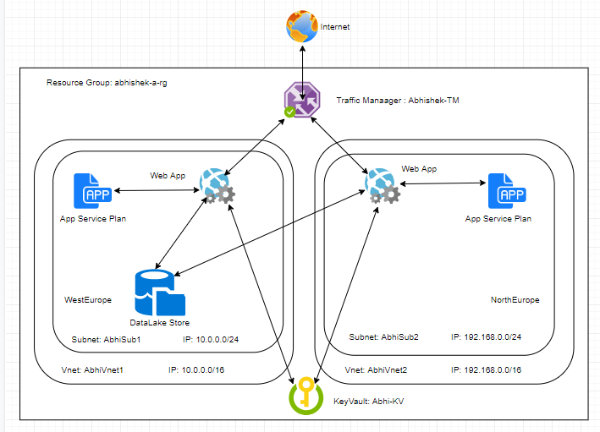
Architecture

Slide 4
Learning
Azure Policy
Builtin Policy
Custom Policy

Slide 5
Challenges
Selecting the Loadbalancer between
Traffic Manager, Loadbalancer and Application Gateway

Slide 6
Demo
Deploying the below resources
Resource Group
Vnet
KeyVault
App Service Plan
WebApp
Traffic Manager
Datalake Store

Slide 7
Query ?
Thank you

